Slide 1


Slide 2
Bento provides a platform for users to document inspiration that they see on a daily basis, and be reminded to come back to it and act on it.

Slide 3
We selected:
a drag and drop interface to create multimedia journal entries.
This allows:
the user to easily capture moments with a convenient drag, and also creation of single entries with multiple pieces of media to capture context

Slide 4
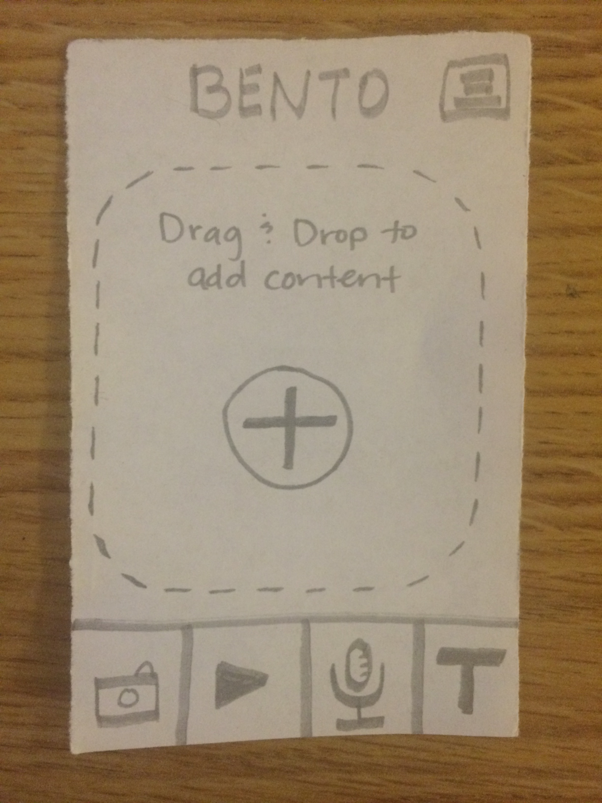
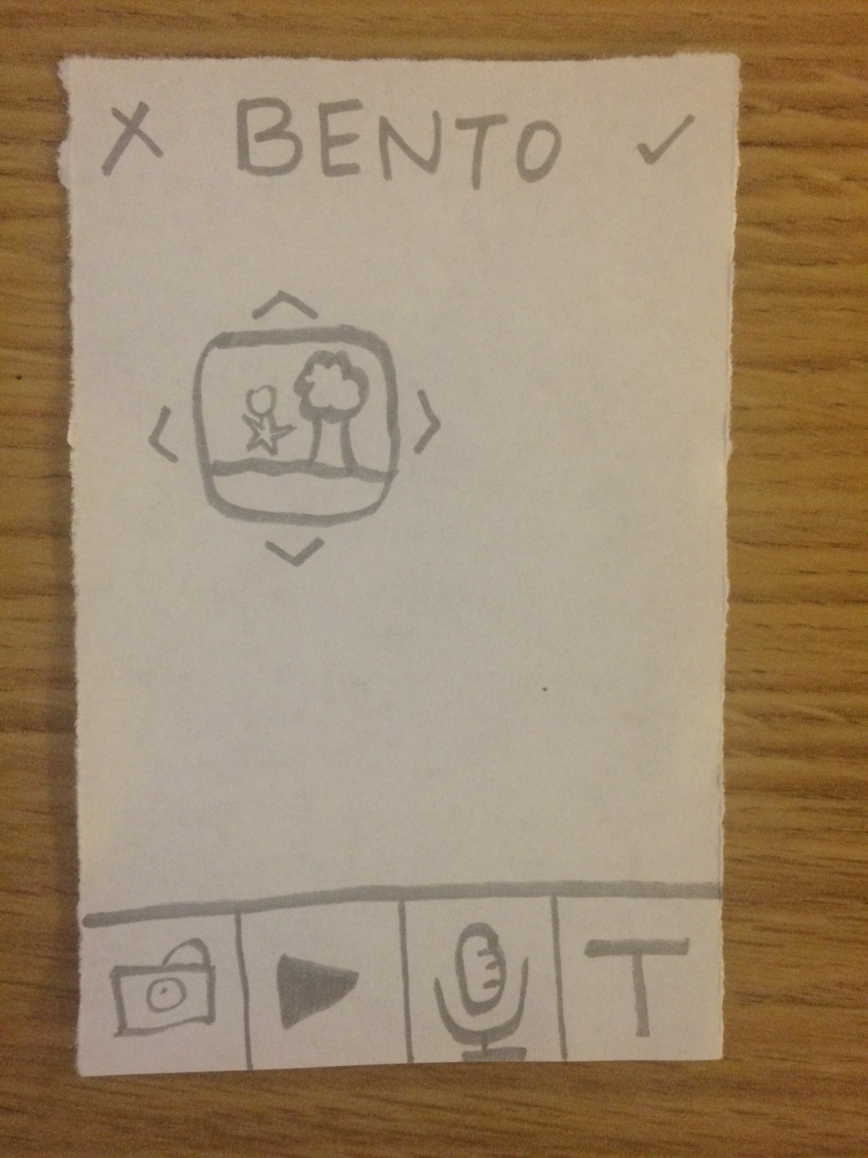
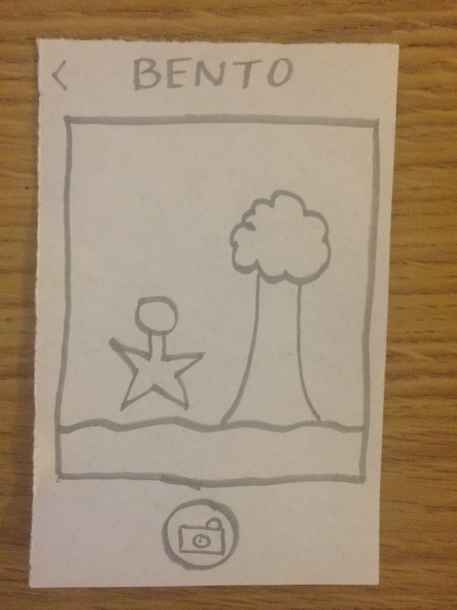
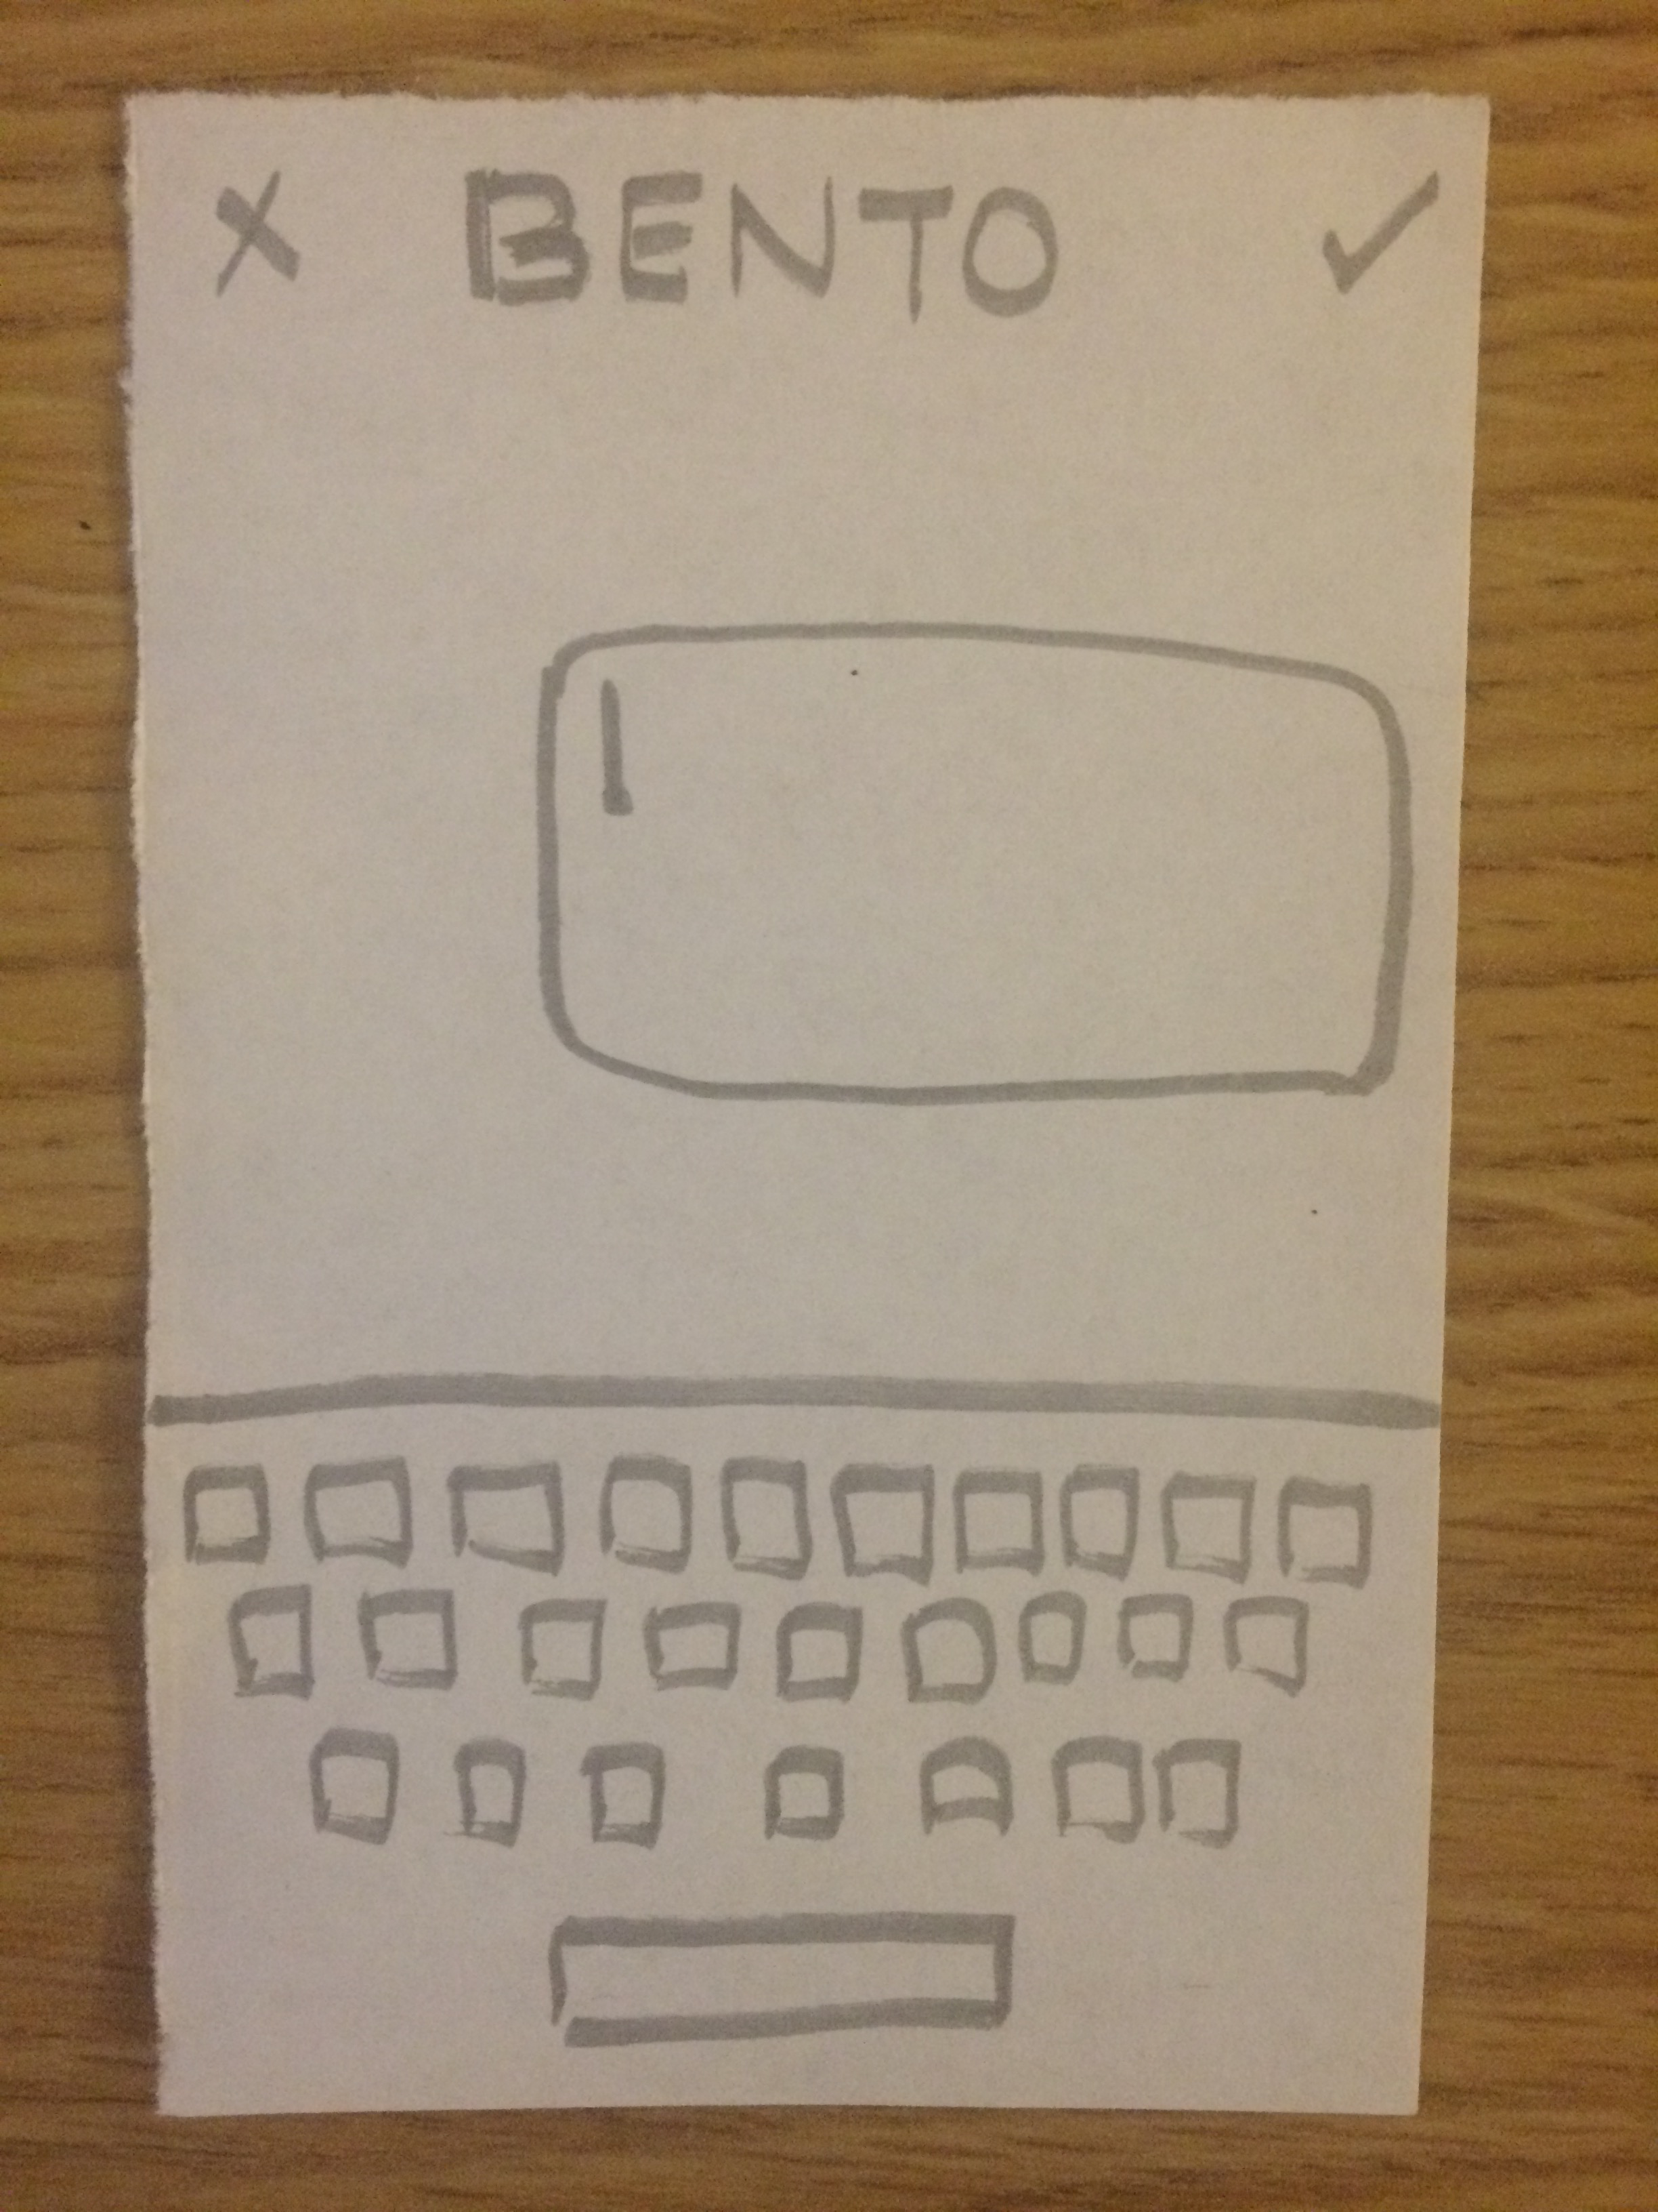
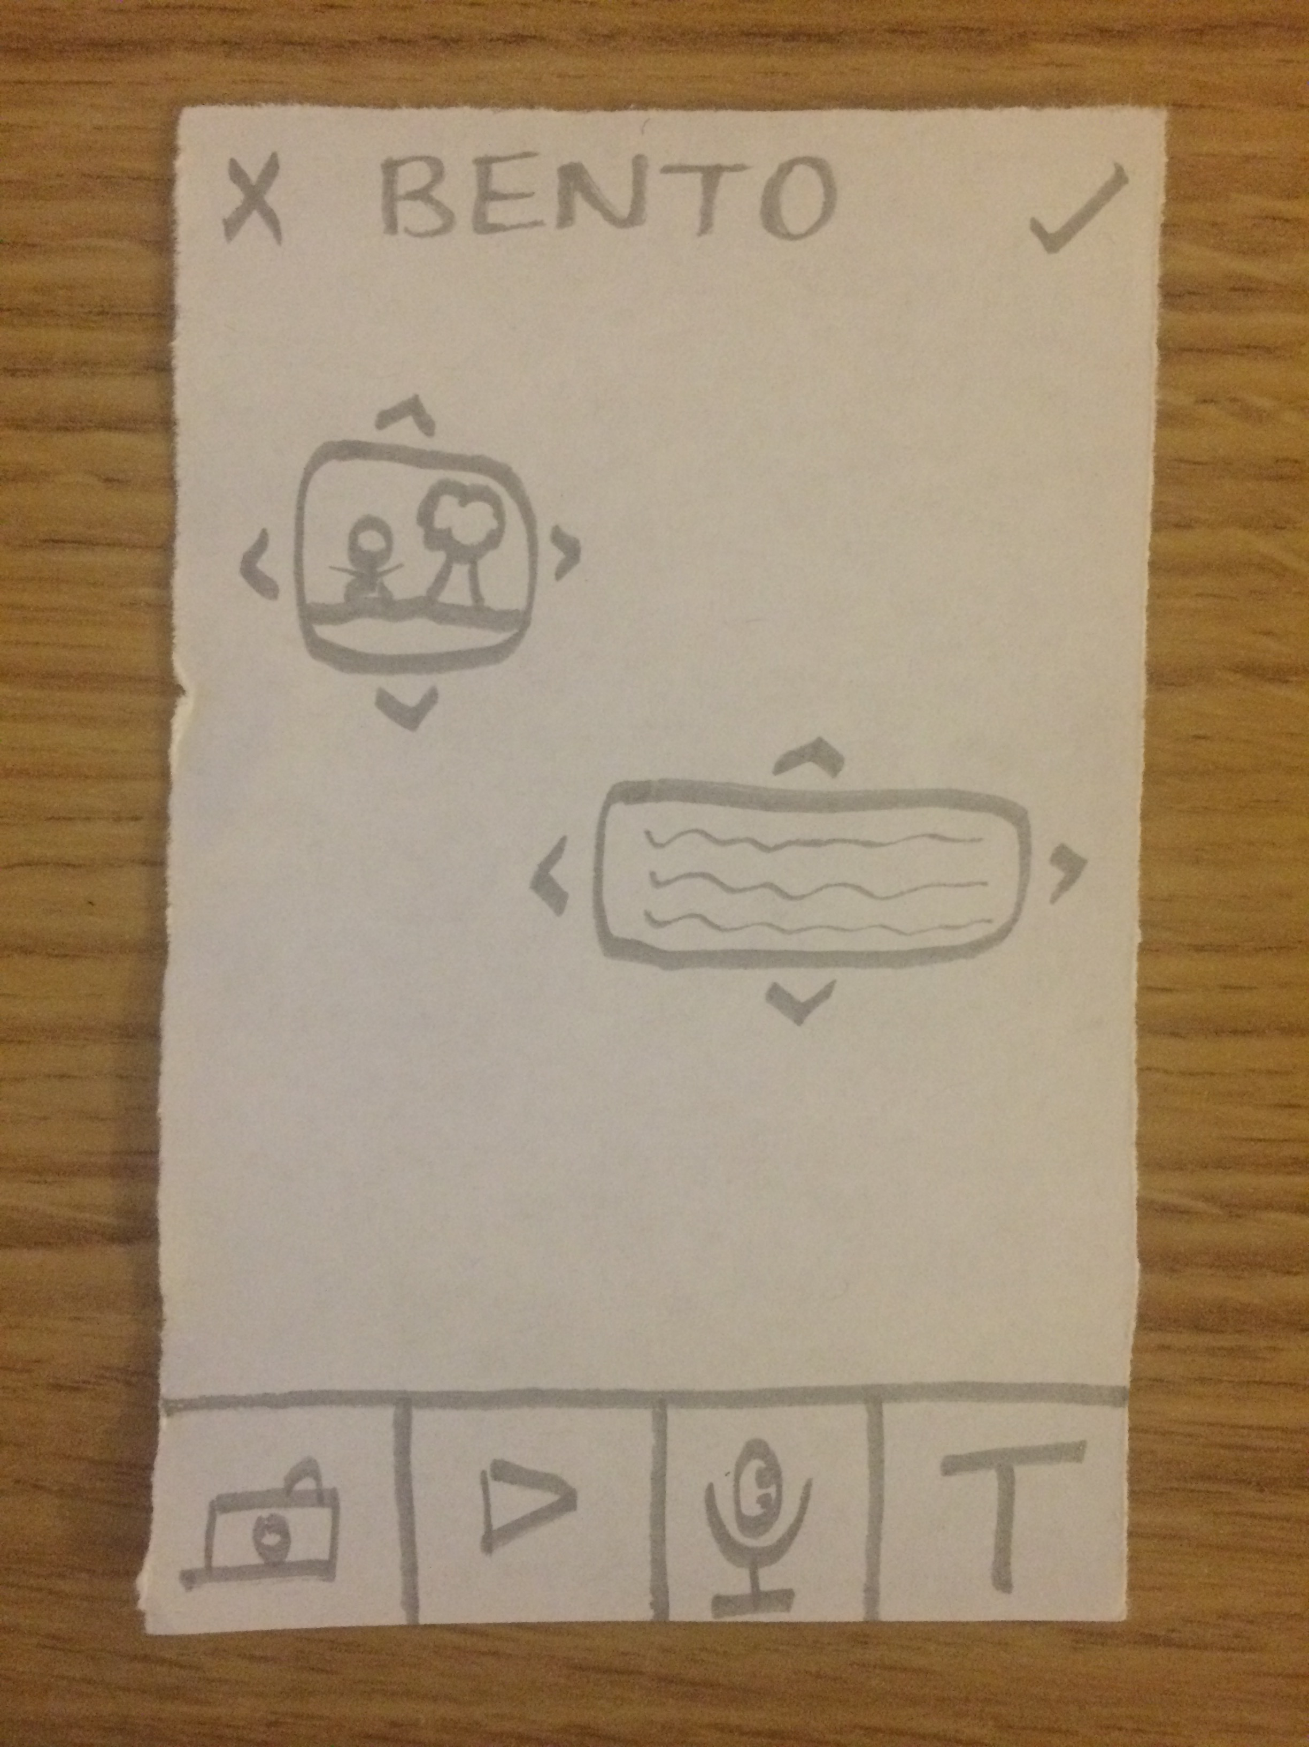
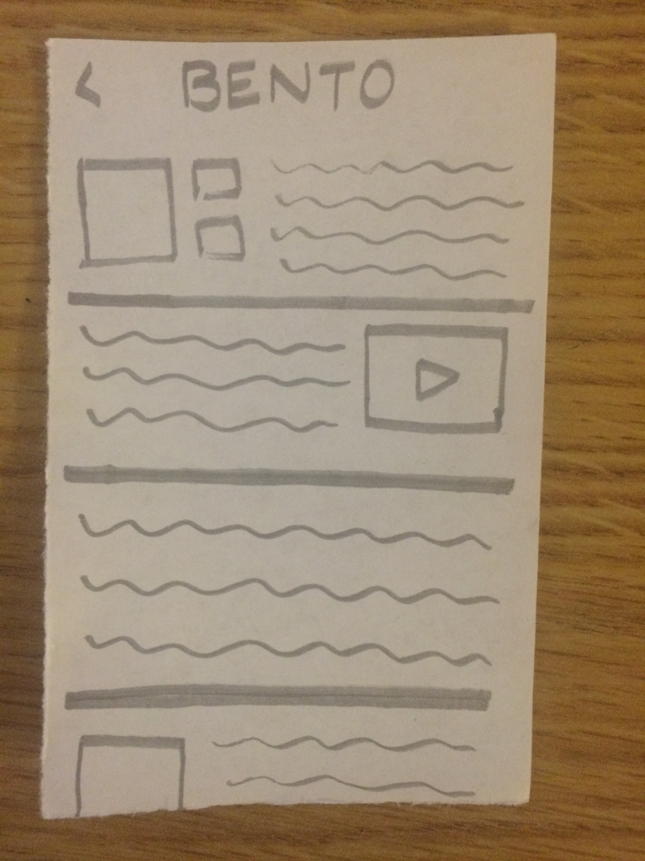
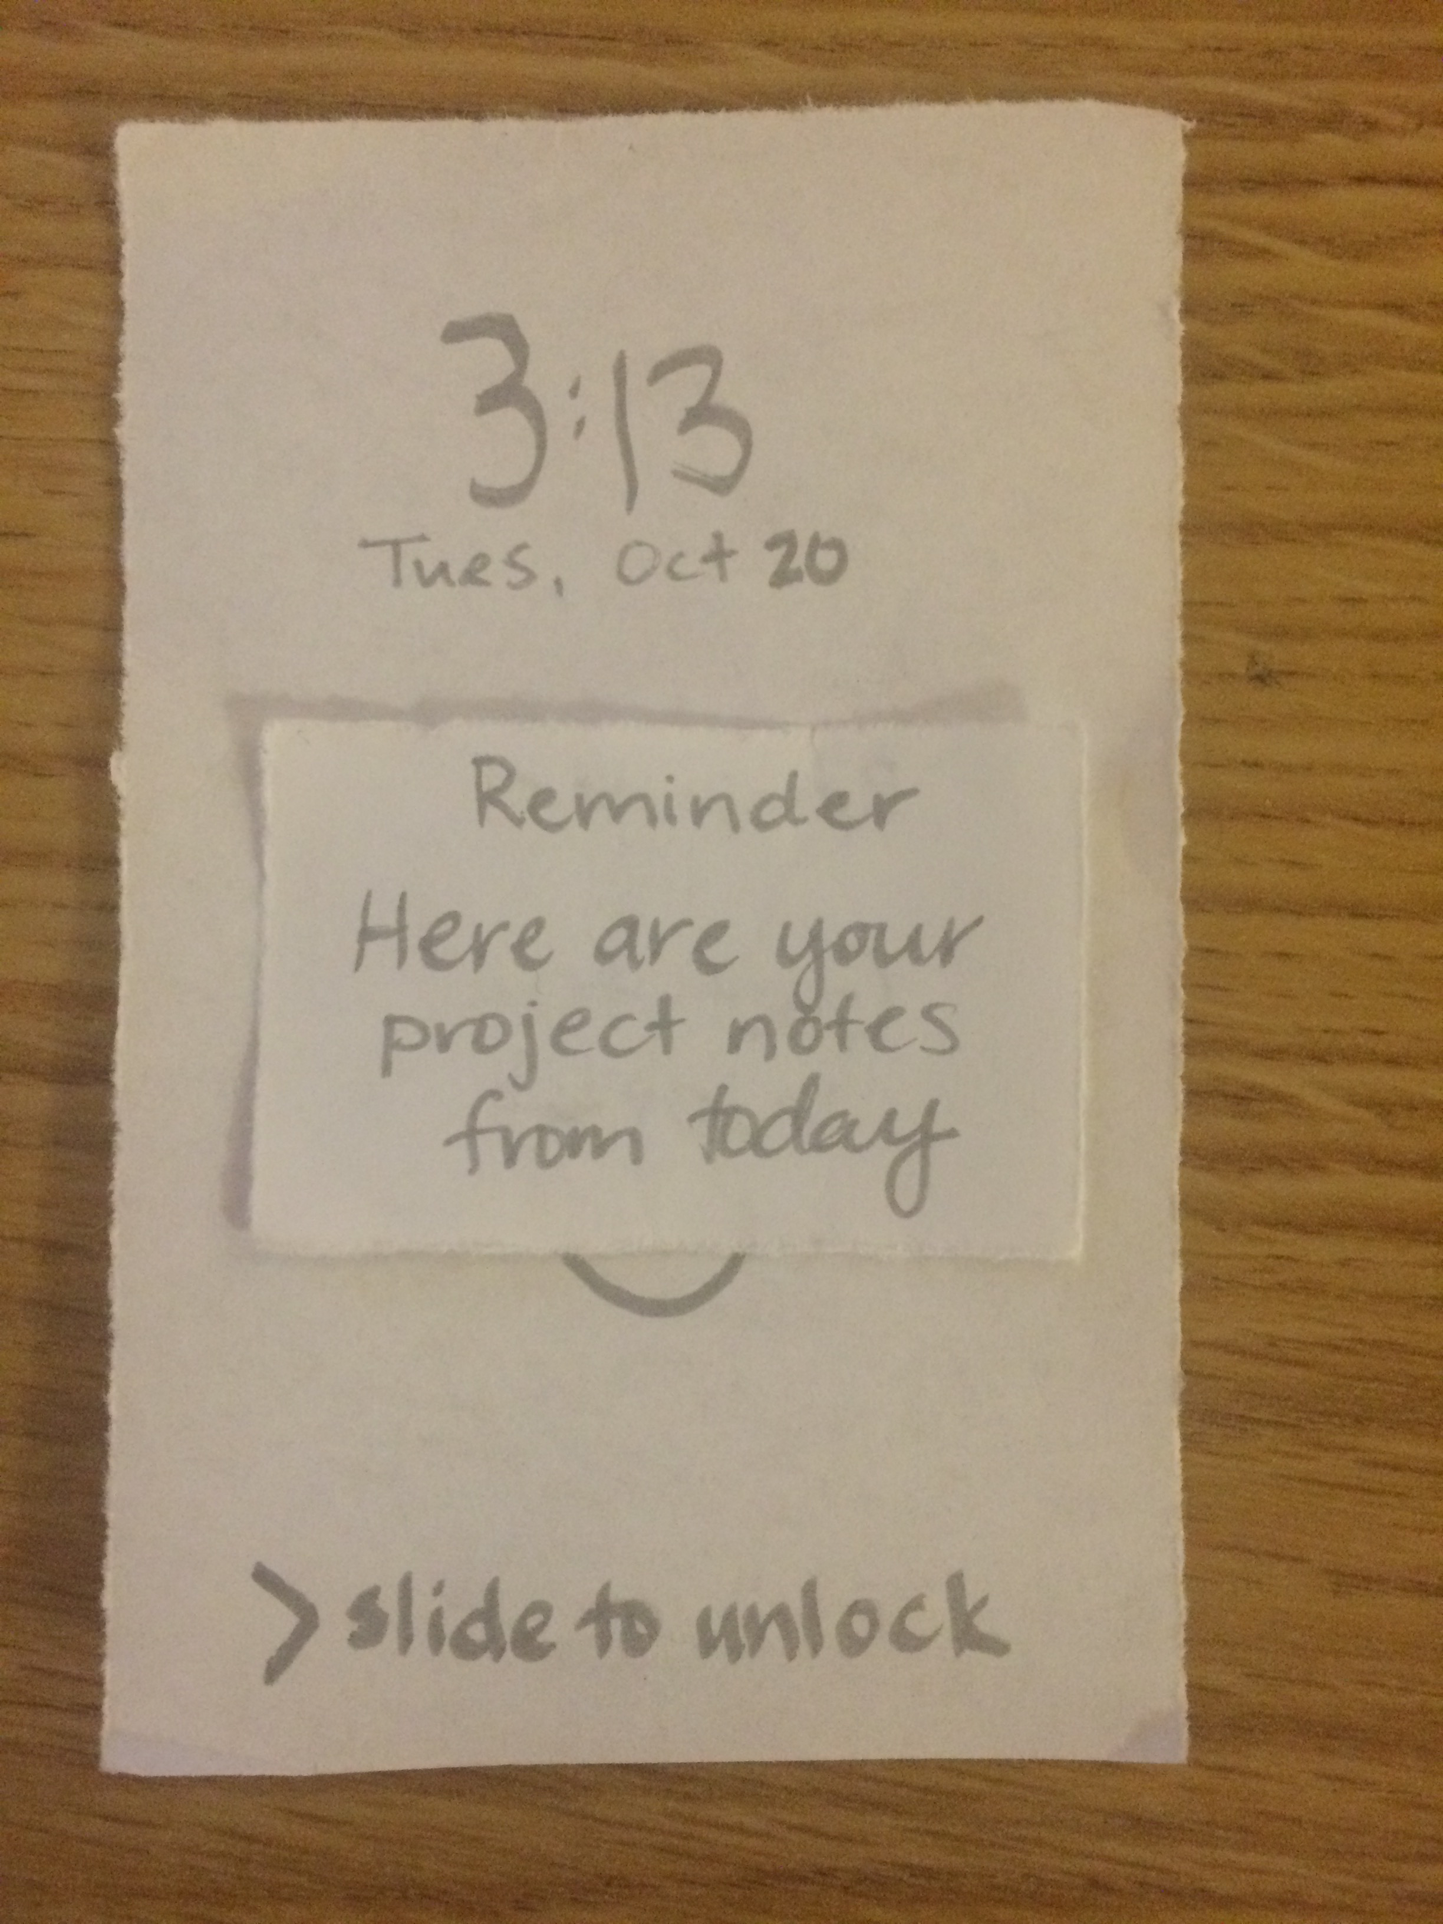

Slide 5
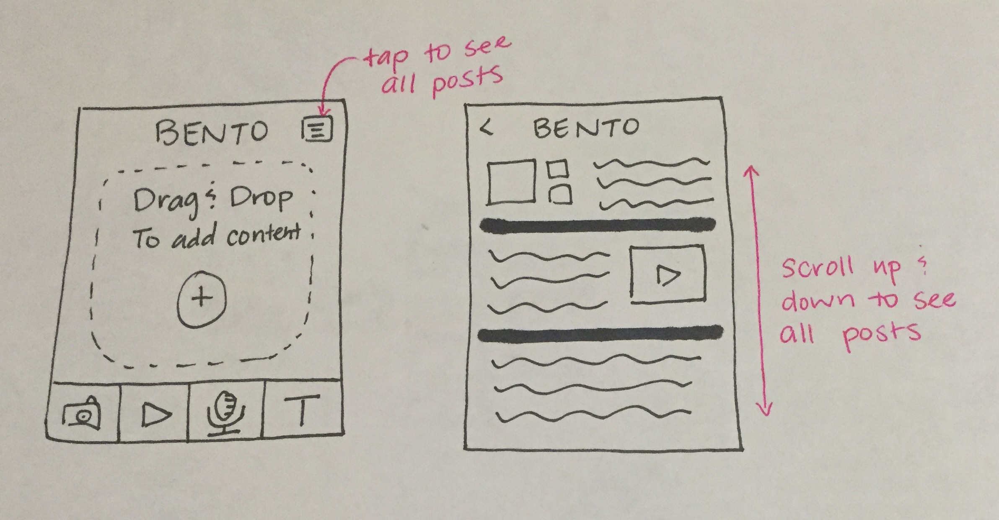

Slide 6
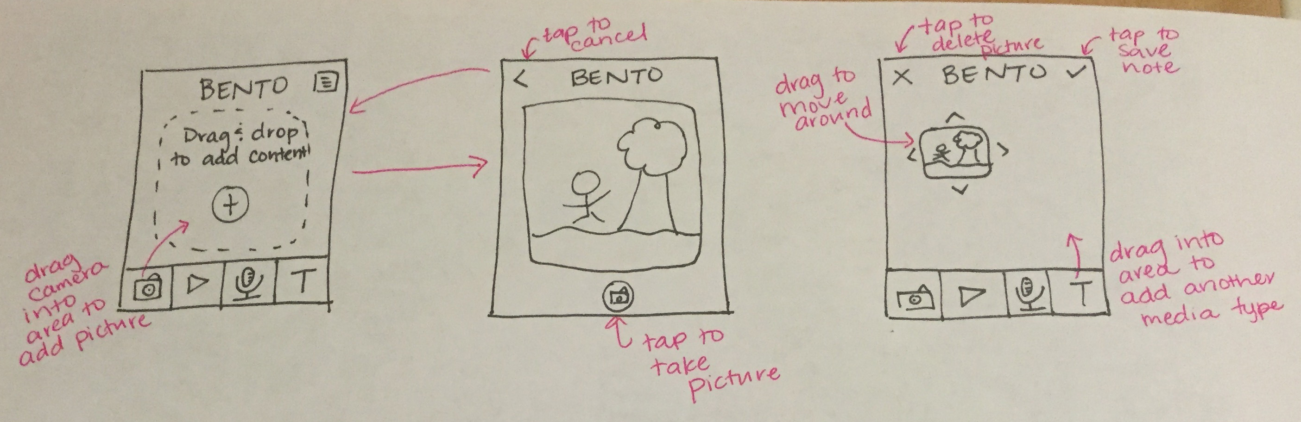

Slide 7
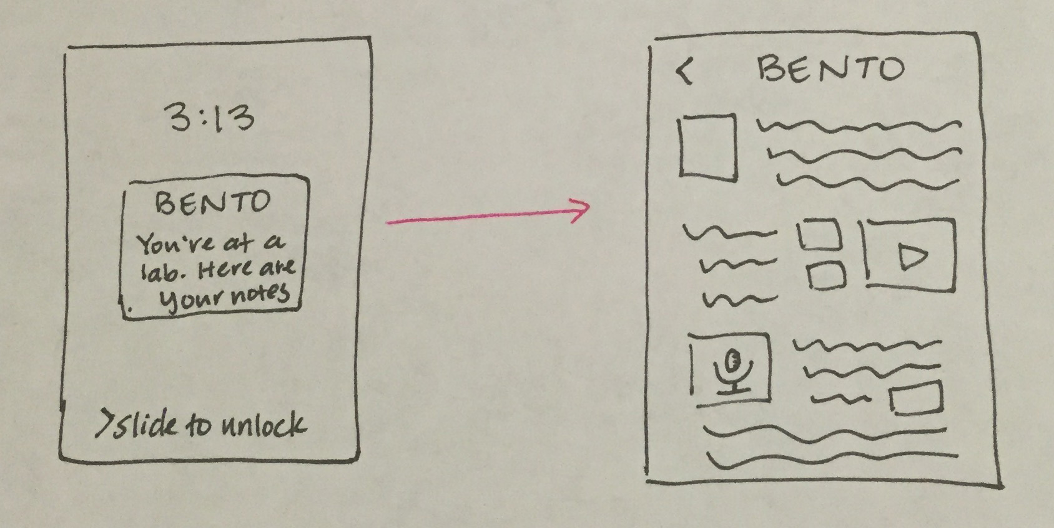

Slide 8
The instructor:
demoed getting reminders and making a text/picture entry
The user:
looked at past entries in the feed, made a new entry with the drag and drop interface, and set himself/herself a reminder for the entry

Slide 9
Participant A:
is collegiate athlete, looking to consolidate academic and athletic notes
He mentioned:
that he needed to be able to import portions of emails his trainer sends him as that is how he receives his workout schedule and related videos

Slide 10
Participant B:
is an artsy writer, working on a creative fiction piece set in medieval times
She spent:
a considerable portion of the time reorganizing the content of her Bento entry into an aesthetically pleasing format

Slide 11
Participant C:
is the social chair of her sorority, trying to track event inspiration and details
She noted:
that she enjoyed the ability to organize ideas in a way that worked for her but that the drag and drop method was unintuitive

Slide 12
Participant A:
needed to be able to import information into Bento
We propose:
to introduce a new functionality into Bento that allows external clipboard use and media insertion

Slide 13
Participant B:
needed an easier way to reorganize all the content within a single Bento entry
We propose:
a function that allows her to temporarily clear her screen and reformat the configuration of her content all at once

Slide 14
Participant C:
interacted with the Bento app in an unsupported way
We propose:
implementing an additional gesture that performs the same function of adding multimedia content

